Slide 1
Optimisation in React Native
K. Anju Munoth

Slide 2
Optimising react native app
Measure, Measure and Measure Again
Every time you do an optimization, test and measure your change
Use a stop watch, use react-native-debugger or whole third other tool — cases vary a lot so measuring before and after reliably is absolutely crucial.

Slide 3
Visualize your bundle
react-native-bundle-visualizer is a great tool for investigating the bundle size.
This will build your app-bundle, help you visualize exactly how big your bundle is and how its size spread on different components and node modules.
Is there something here that stands out? Do you really need moment taking up 6% of your apps bundle size?

Slide 4
Load Only What You Need When You Need It
Dynamically import areas or dependencies as you need them
This is one of the biggest improvements you can do to start up time.
It’s one of those things that are a lot more complex than it should be in react native but its definitely worth it.

Slide 5
Delay anything that isn’t crucial for the user
Can see this effect very much on apps like facebook or instagram, they load the bare minimum, then progressively load more and more.
This means data fetching and heavy components, the devices are incredibly fast out there, perceived performance is all about loading the most important stuff first.

Slide 6
Optimize and standardize assets
Optimizing assets in your React Native apps provides an easy way to achieve big performance gains with little effort.
Can use software like ImageOptim — or automate the whole process

Slide 7
optimizing assets in react native
ImageOptim - works by optimizing pngs and jpgs losslessly, by applying several different compression algorithms, stripping all metadata and other things that you don’t need in production.

Slide 8
Embrace perceived performance
Performance isn’t only execution time, it’s the feeling of a fast app experience you want in the end.
Perceived performance is all the tricks you can do to make it seem like your app is running faster and better.
Things like letting your splash screen stay until all your javascript is loaded or using react-native-shimmer to let your user see where the content as its loaded.

Slide 9
Utilize as much open source as possible and keep them up to date
Can almost never outperform the big open source projects out there.
There are thousands of contributors and their range of devices and knowledge between the developers are often far greater than what a company or team has to offer.

Slide 10
Choosing The Right External Libraries
An external Library plays a major role when it comes to making enterprise applications using React-Native, where you hunt for JavaScript Libraries where you can achieve what you have in your mind instead of creating components from scratch, but the ecosystem also has some serious disadvantages as developers not knowing what's inside at every part.
Mobile-App Development has its own set of rules, while in the case of web applications where the size of assets is crucial where it is not that equally needed in React-Native where the filesystem consists of your assets.
To make sure that your React-Native provides the best performance on the majority of mobile devices who have to choose the right External Libraries.
Using only smaller and specialized libraries.
Always check for alternatives with the same requirements you are looking for.

Slide 11
Optimizing Startup Time
Every user will expect the applications to be super responsive and able to load fast, otherwise, you will start getting many bad ratings on the app stores which you don't want to happen.
Using Hermes you can solve these issues pretty easily,
Hermes is a JavaScrip Engine keeping React Native in mind, it focuses on the CPU metrics such as the application’s size & interaction time.
Hermes uses an AOT compiler (ahead of time), whereas the majority of the engines use JIT (just in time) which means that the entire bundle is compiled to bytecode ahead of time.

Slide 12
Avoid Use of ScrollView to Render Huge Lists
ScrollView is simple to implement. It is often used to iterate over a list of a finite number of items
However, it renders all children at once. This approach is good when the number of items in the list is quite low.
On the other hand, using ScrollView with a large amount of data can directly affect the overall performance of the React Native app.
To handle large amounts of data in the list format, React Native provides FlatList. The items in FlatList are lazy loaded. Hence, the app does use an excessive or inconsistent amount of memory

Slide 13
Avoid Passing Inline Functions as Props
When passing a function as a property to a component, avoid passing that function inline
Isn’t recommended because any time the parent re-renders a new reference, the function is created again. This means that the child component re-renders even when the props didn’t change at all.
The solution is to declare the function as a class method or as a function inside a functional component so that the references remove any possibility of across re-renders.

Slide 14
Scale and Resize Images
Important to optimize images to improve your React Native app’s performance if the app is built to showcase a huge amount of graphical content or images.
Rendering multiple images could lead to high memory usage on a device if the images are not appropriately optimized in terms of resolution and size.
This may cause your app to crash due to memory overload.
Using PNG format instead of JPG format
Using smaller-resolution images
Using WEBP format for images – this can help reduce the images' binary size on iOS and Android by nearly a third of the original size!

Slide 15
Use nativeDriver With the Animated Library
One of the most popular ways to render animations in React Native apps is using the library.
It uses nativeDriver to send animations over the native bridge before the animation starts on the screen.
This helps the animations to be executed independent of blocked JavaScript threads, thus resulting in a smoother and richer experience without flickering or dropping many frames

Slide 16
Use Style References Correctly
If you use objects or arrays for styling, they will create new instances with each new render.
Should use a StyleSheet in React Native, which always passes a reference instead of a new object or array creation and allocation.

Slide 17
Memoize expensive computations
React introduced the memo HOC (Higher Order Component) in React 16.6 for preventing unnecessary re-rendering and the useMemo hook in React 16.8 for optimizing expensive computations.
However, it is also possible to use the useCallback hook to do that. The major difference between useMemo and useCallback is that useMemo returns a memoized value but useCallback returns a memoized callback.
React.memo was introduced to functional components to serve the same purpose the React PureComponents serves in class components. memo prevents unnecessary re-rendering of a component and could help to optimize an application.

Slide 18
Cache images locally
Caching is another solution to image problems in a React Native app.
Saves the images locally the first time they are loaded and uses the local cache in the subsequent requests.
This could improve the app performance remarkably.
react-native-fast-image and react-native-cached-image – for caching images.

Slide 19
Manage Staging and Production Environments
To expose env variables to react-native- use the react-native-config library.
Keep the config variables away from the code.
Vars are going to be different across environments, while the code is not.
Create 3 env files in the root of the project: one for the local environment, simply called .env, and another two called .env.staging and .env.production.

Slide 20
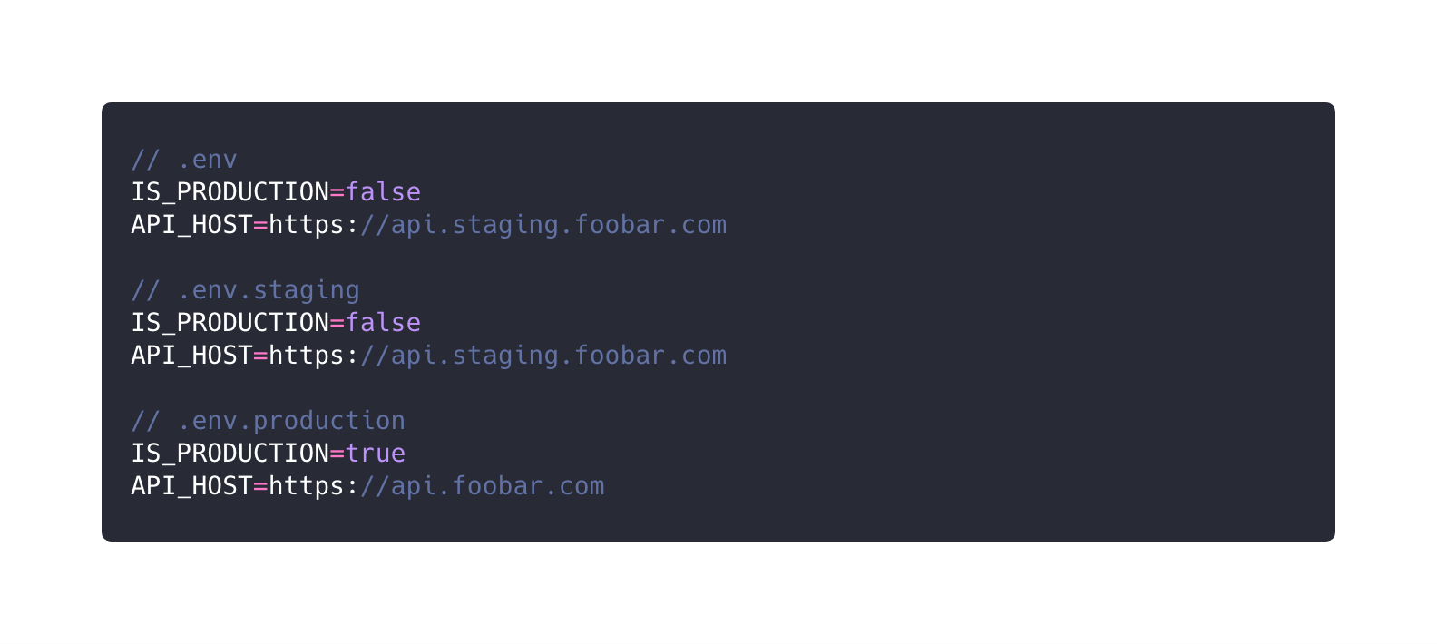

Slide 21
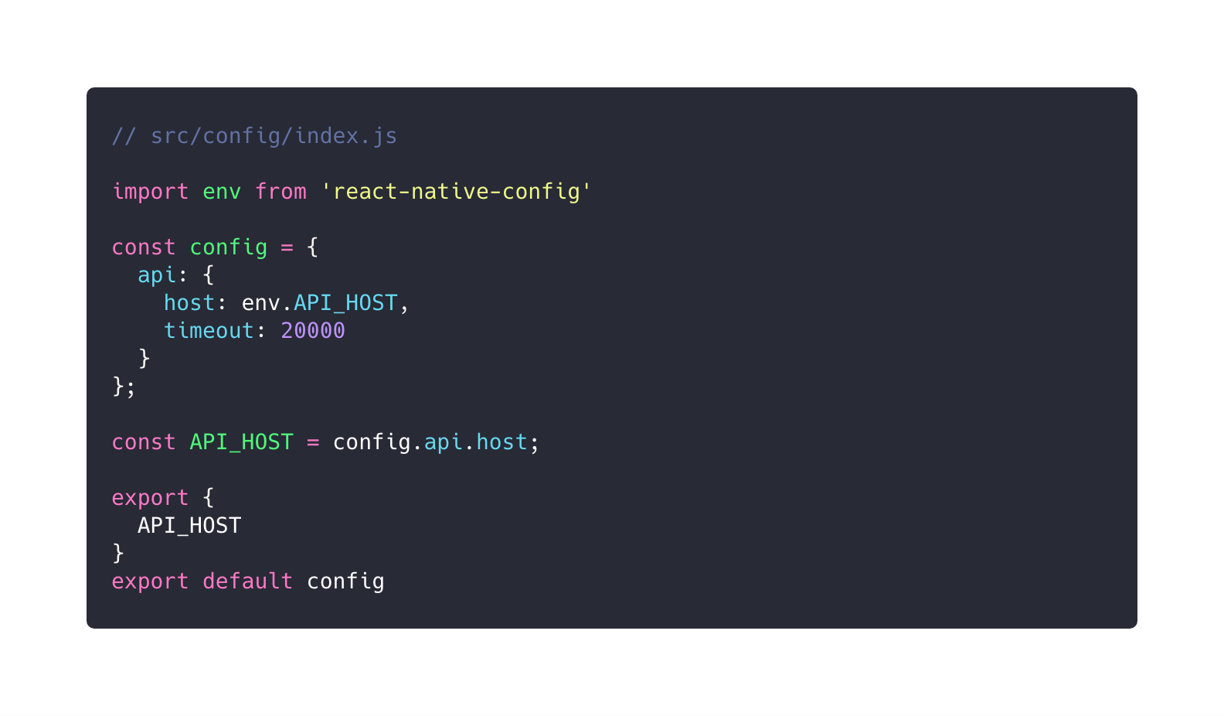

Slide 22
